Slide 1
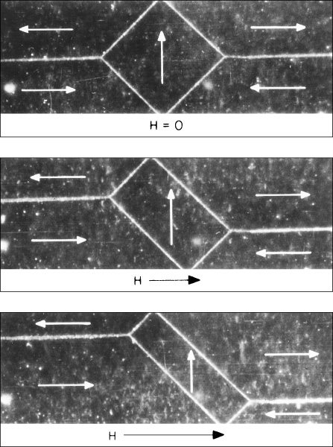
c18cof01
Magnetic Properties
Iron single crystal photomicrographs
magnetic domains change shape as a magnetic field (H) is applied.
domains favorably oriented with the field grow at the expense of the unfavorably oriented domains.

Slide 2
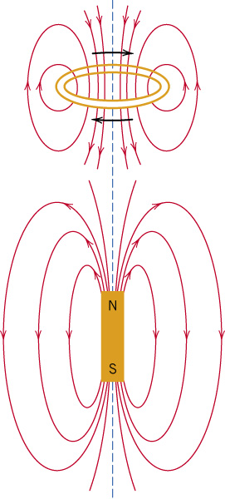
c18f01
18.2 Basic Concepts
Magnetic forces appear when moving charges
Forces can be represented by imaginary lines grouped as fields
c18f01
Magnetic field lines of force around a current loop and a bar magnet.

Slide 3
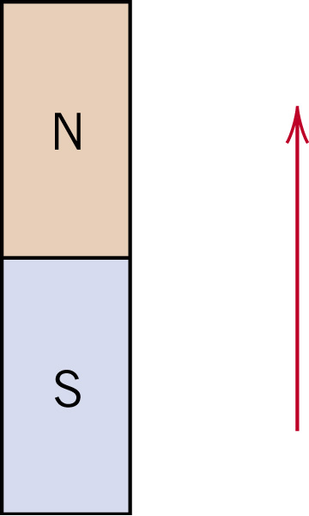
c18f02
MAGNETIC DIPOLES
The magnetic moment represented by a vector

Slide 4
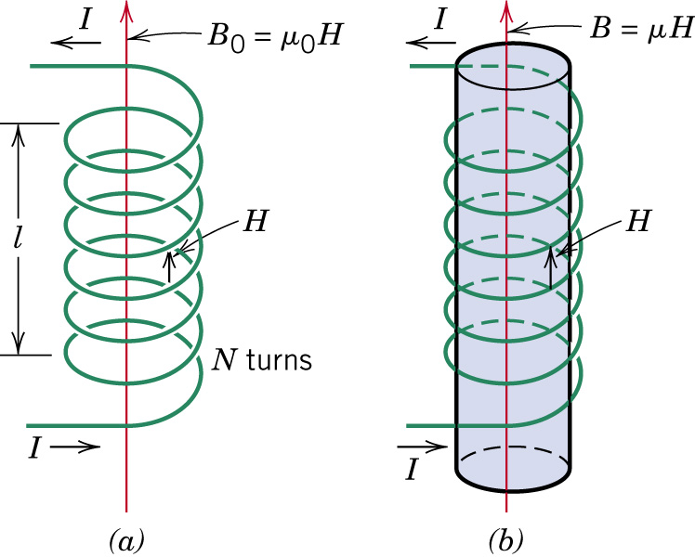
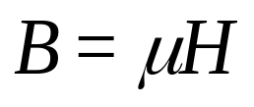
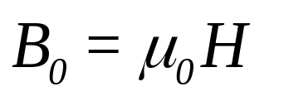
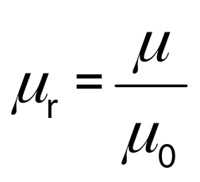
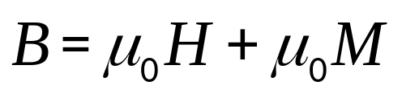
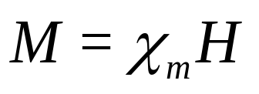
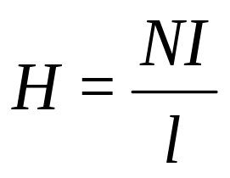
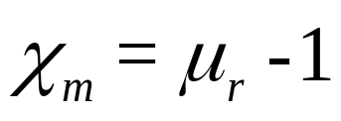
c18f03
Magnetic Field Vectors
magnetic field strength (H) & magnetic flux density (B)
Magnetic flux density
relative permeability
magnetization
magnetic susceptibility
Magnetic field strength
c18f03

Slide 5
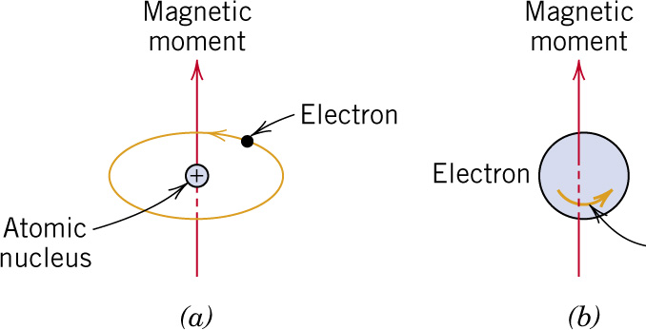
c18f04
Origins of Magnetic Moments:
Responds to quantum mechanics laws
Two main contributions: (a) an orbiting electron and (b) electron spin.
The spin is an intrinsic property of the electron and it is not due to its rotation
Bohr magneton (μ_{B})
Most fundamental magnetic moment
μ_{B} = ±9.27x10⁻²⁴ A-m²

Slide 6
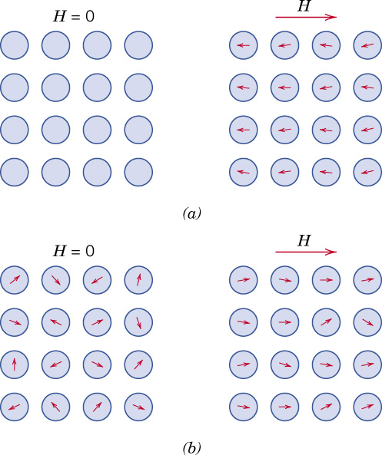
c18f05
18.3 Diamagnetism and Paramagnetism
Diamagnetic material
in the presence of a field, dipoles are induced and aligned opposite to the field direction.
Paramagnetic material
c18f05

Slide 7
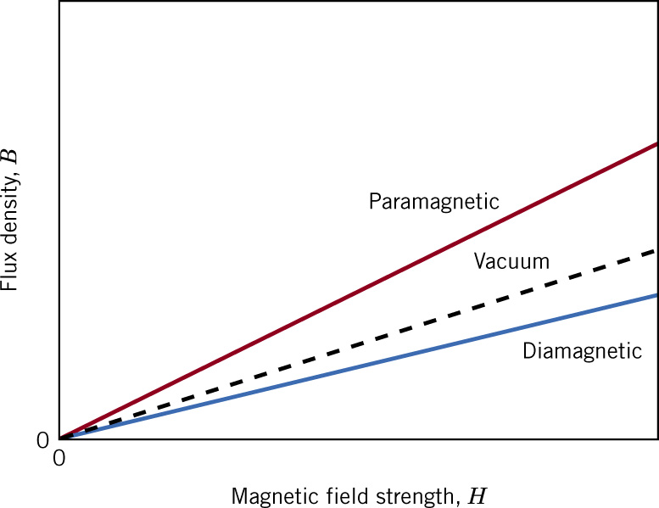






c18f06
The flux density B versus the magnetic field strength H for diamagnetic and paramagnetic materials.
c18f06

Slide 8
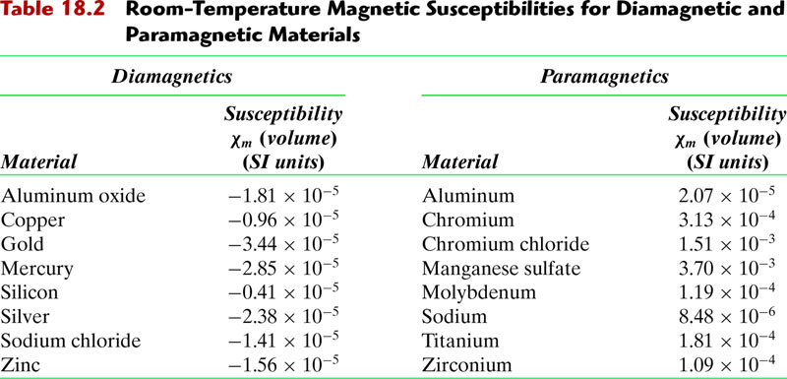
c18tf02
c18tf02

Slide 9
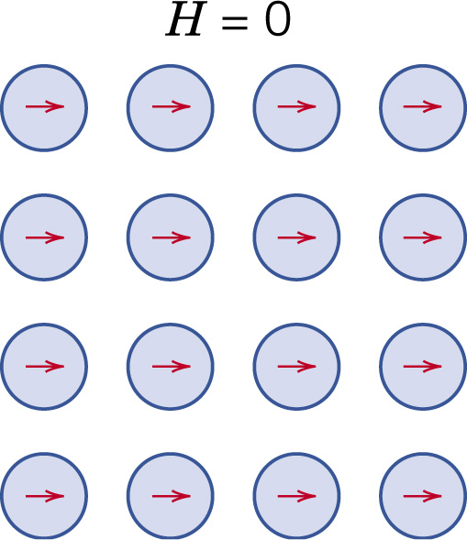
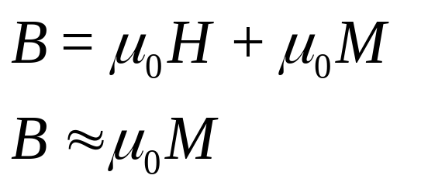
c18f07
18.4 FERROMAGNETISM
mutual alignment of atomic
dipoles
even in the absence of an external magnetic field.
coupling forces align the magnetic spins
Domains with mutual spin alignment
B grows up to a saturation magnetization M_{s} with a saturation flux
B_{s} = M_{atom} × N_{atoms} (average moment per atom times density of atoms)
M_{atom} = 2.22μ_{B}, 1.72μ_{B}, 0.60μ_{B} for Fe, Co, Ni, respectively

Slide 10
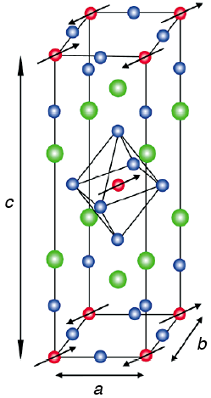

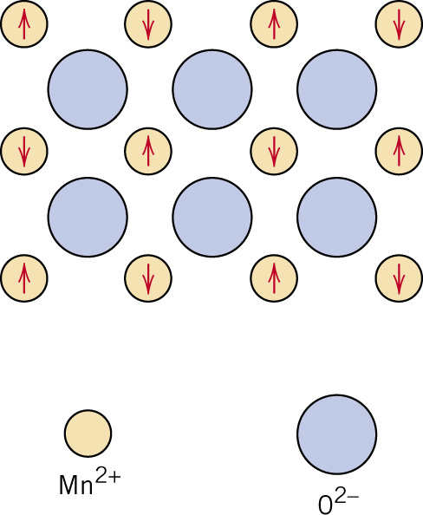
c18f08
18.5 Antiferromagnetism & Ferrimagnetism
1986: superconductivity discovered in layered compound La_{2-x}Ba_{x}CuO₄ with a transition T much higher than expected. Little was known about copper oxides
ANTIFERROMAGNETISM
Antiparallel alignment of spin magnetic moments for antiferromagnetic manganese oxide (MnO)
At low T
Above the Neel temperature they become paramagnetic
c18f08
Parent materials, La₂CuO₄, and YBa₂Cu₃O₆, demonstrated that the CuO₂ planes exhibit antiferromagnetic order.
This work initiated a continuing exploration of magnetic excitations in copper-oxide superconductors, crucial to the mechanism of high-temperature superconductivity.

Slide 11
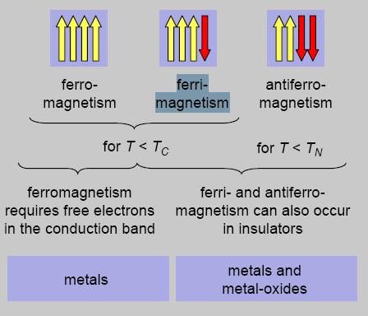
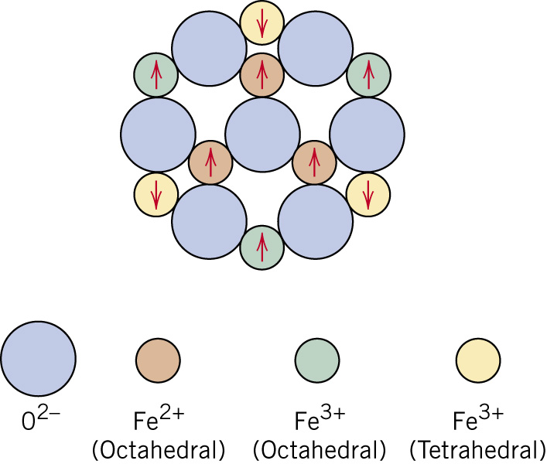
c18f09
FERRIMAGNETISM
spin magnetic moment configuration for Fe²⁺ and Fe³⁺ ions in Fe₃O₄. Above the Curie temperature becomes paramagnetic

Slide 12
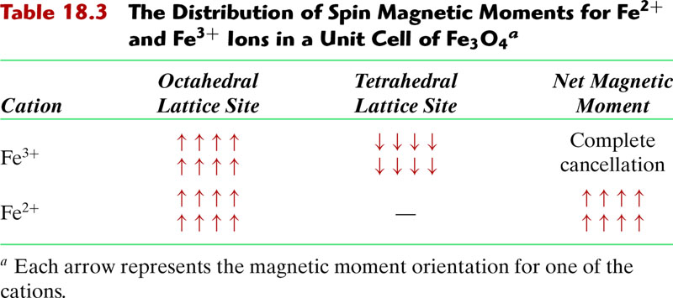
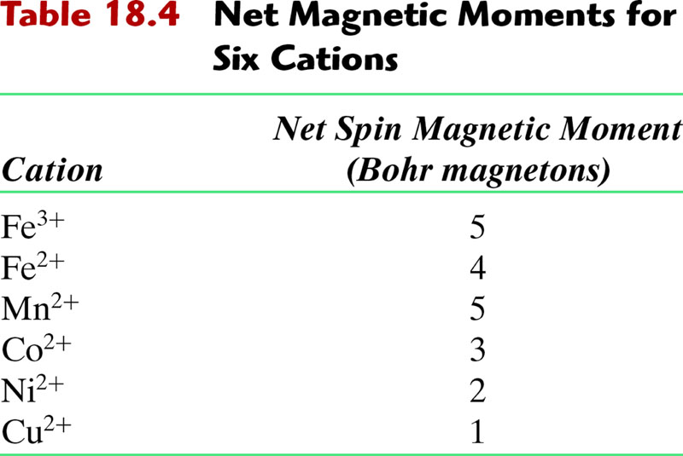
c18tf03
18tf03

Slide 13
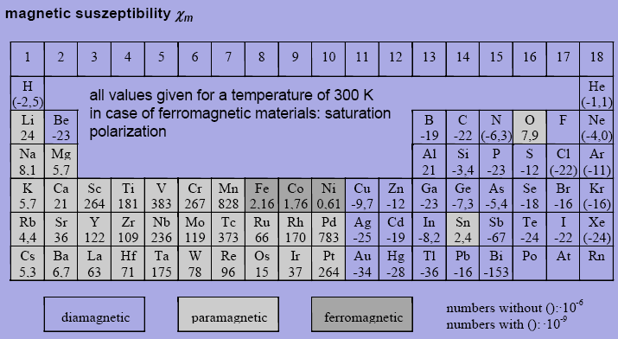
In our textbook 2.22, 1.72, 0.61

Slide 14
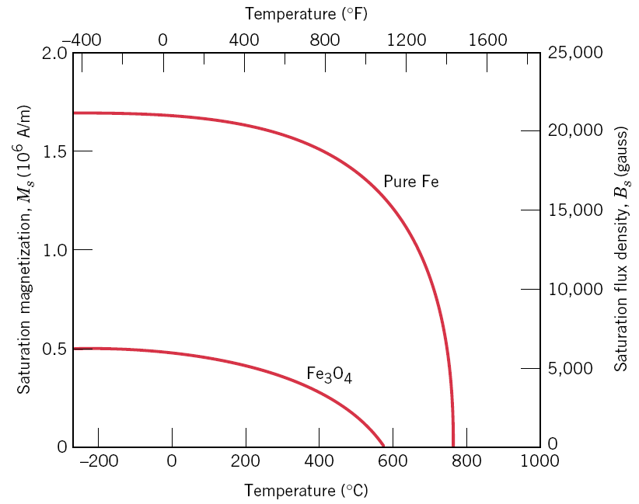
c18f10
18.6 The Influence of Temperature on magnetic Behavior
T_{C}: Curie temperature (ferromagnetic, ferrimagnetic)
T_{N}: Neel temperature (antiferromagnetic)
material become paramagnetic

Slide 15
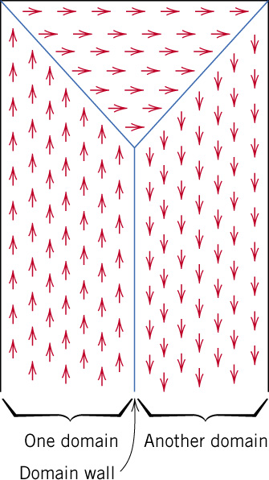
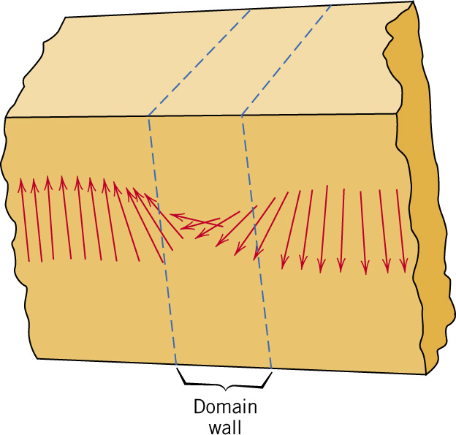
c18f11
18.7 Domains and Hysteresis
Domains in a ferromagnetic or ferrimagnetic material; arrows represent atomic magnetic dipoles.
Within each domain, all dipoles are aligned, whereas the direction of alignment varies from one domain to another.
Gradual change in magnetic dipole orientation across a domain wall.
c18f11
c18f12

Slide 16
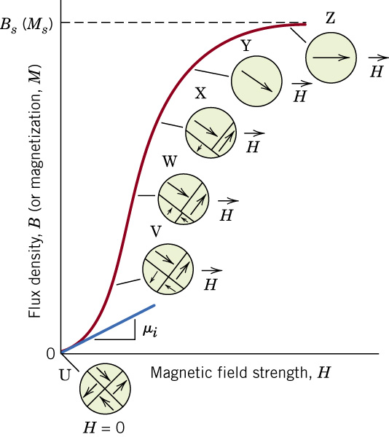
c18f13
B versus H
ferromagnetic or ferrimagnetic material
initially unmagnetized
Domain configurations during several stages of magnetization
Saturation flux density, B_{s}
Magnetization, M_{s},
initial permeability μ_{i}
c18f13

Slide 17
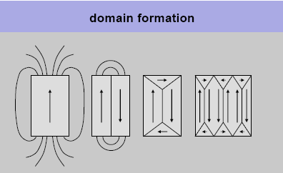
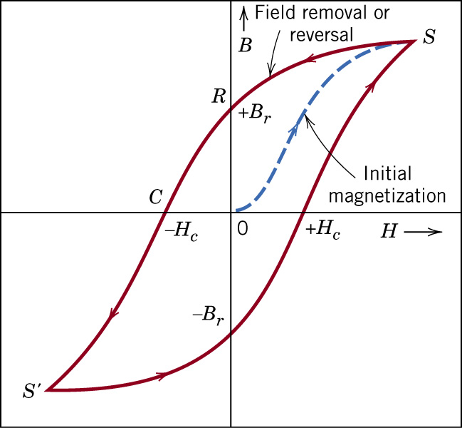
c18f14
Magnetic flux density versus magnetic field strength
ferromagnetic material subjected to forward and reverse saturations (S & S’).
hysteresis loop (red)
initial magnetization (blue)
remanence, B_{r}
coercive force, H_{c}
c18f14

Slide 18
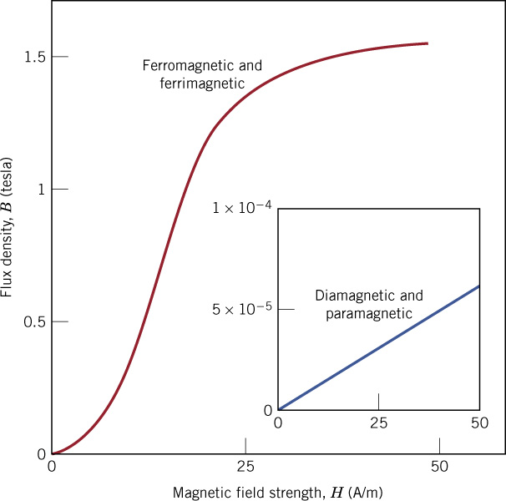
c18f16
Comparison magnetic versus nonmagnetic
c18f16

Slide 19
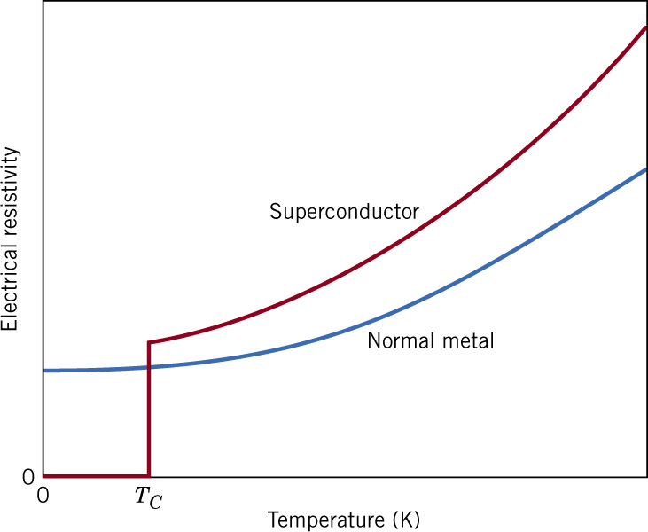
c18f26
18.12 Superconductivity
Temperature
dependence of the electrical resistivity
for normally conducting and
superconducting materials in the
vicinity of 0 K.

Slide 20
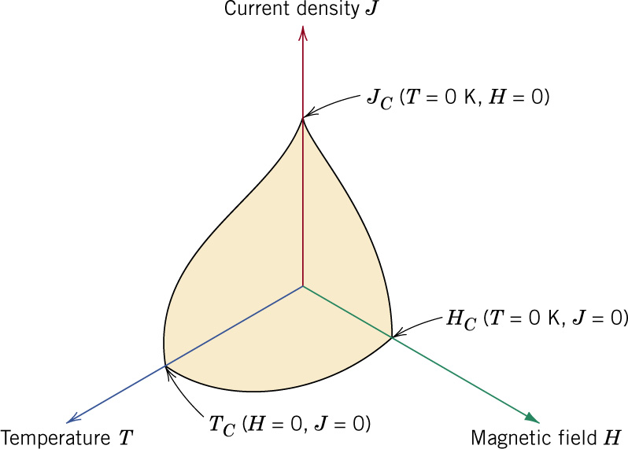
c18f27
Critical temperature,
current density, and magnetic
field boundary separating
superconducting and normal
conducting states (schematic).
c18f27

Slide 21
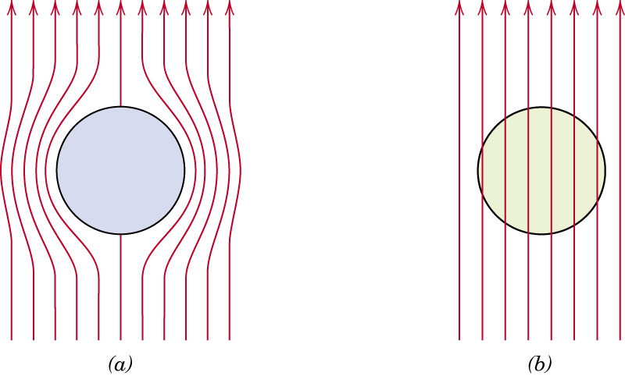
c18f28
Representation of
the Meissner effect.
While in the superconducting state, a body of material (circle) excludes a magnetic field (arrows) from its interior.
The magnetic field penetrates the same body of material once it becomes normally conductive.

Slide 22
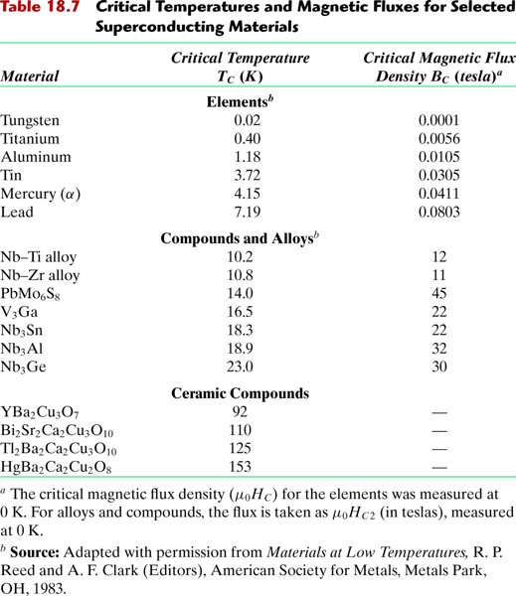
c18tf07
c18tf07

Slide 23
SUMMARY
• A magnetic field can be produced by:
--putting a current through a coil.
• Magnetic induction:
--occurs when a material is subjected to a magnetic field.
--is a change in magnetic moment from electrons.
• Types of material response to a field are:
--ferri- or ferro-magnetic (large magnetic induction)
--paramagnetic (poor magnetic induction)
--diamagnetic (opposing magnetic moment)
• Hard magnets: large coercivity.
• Soft magnets: small coercivity.
• Magnetic storage media:
--particulate γ-Fe2O3 in polymeric film (tape or floppy)
--thin film CoPtCr or CoCrTa on glass disk (hard drive)
10

